Slide 1

>A Brief RL Overview Value Iteration, Multi Armed Bandits, Policy Iteration, Policy Evaluation
Ugurkan Ates 23.05.2020

Slide 2
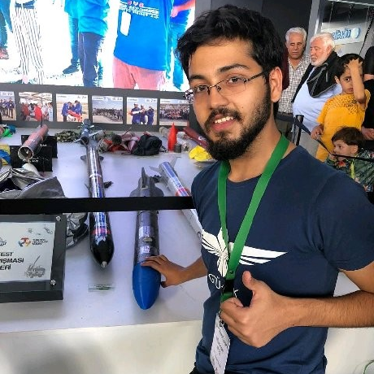




Uğurkan Ateş
Machine Learning Engineer
@ Accenture
Reinforcement Learning Turkiye - 2020
Deep Learning Turkiye - 2019
GTU Bilgisayar Muhendisligi 2015
To ask Questions
https://github.com/ugurkanates
https://www.linkedin.com/in/uğurkan-ateş/
ugurkanates97@gmail.com
https://medium.com/@paypaytr

Slide 3
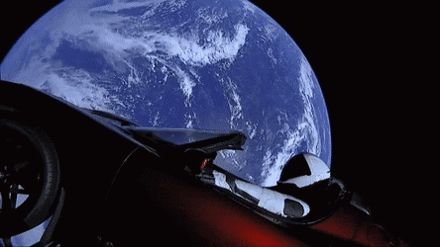
Value Iteration
01
Value Function definition, how to calculate it
Policy Evaluation
02
How to evaluate policy , with random fixed policy. Does it converge?
Policy Iteration
Overview
03
Evaluate the policy and improve it to get optimal policy
Multi Armed Bandits
04
What is the problem space, what algorithms / methods used , exploration and exploitation dilemma.
Q & A's
05
Q-A part

Slide 4
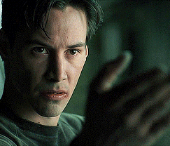
01
Value Iteration
“ Talk is cheap , show me the code “ – Linus Torvalds

Slide 5
What is Value Function?
Value function Value(observation) / V(s) measures how good to be in a spesific state.
Very useful concept as Value based algorithms just greedly chooses best value to be in that state.
Hybrid approaches also use in their Advantage calculation
Notice : Policy Gradient methods doesn't try to optimize value function directly.

Slide 6
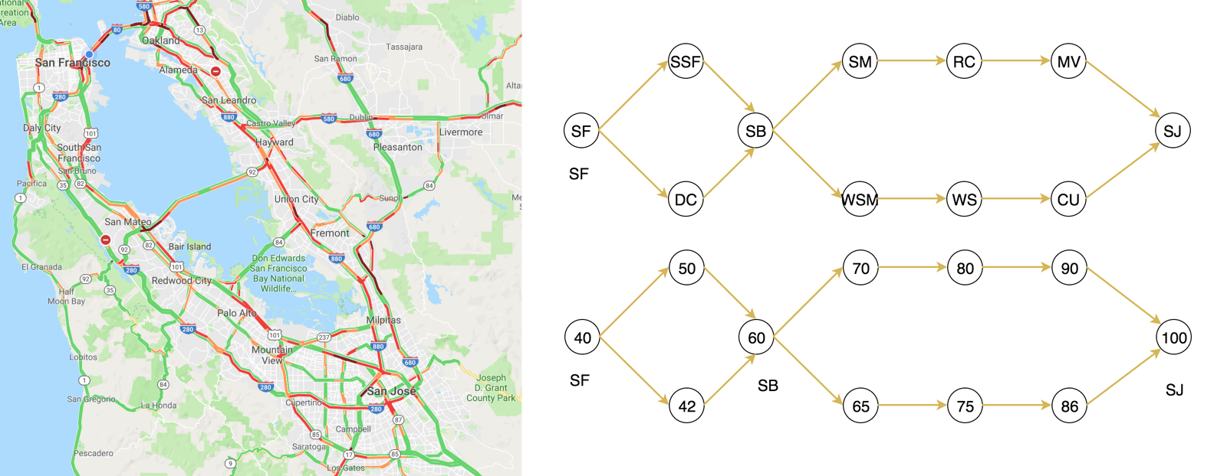
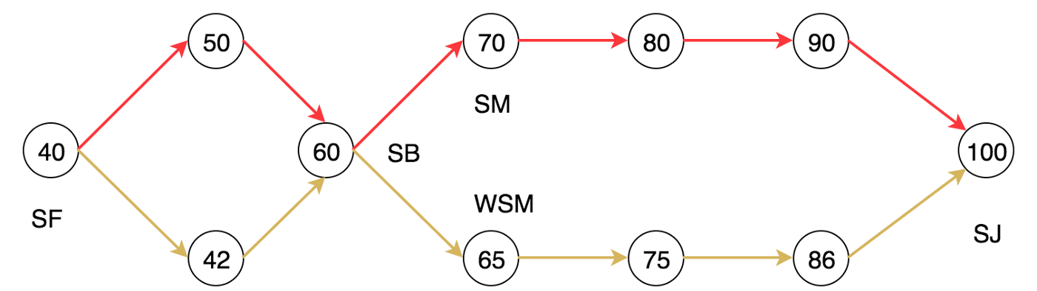
Example Value Function
Notes:
San Fransisco , San Bruno which way , choosing which state would arrive at most score? Which is what we are trying to achieve, traffic , money , possibility of travel failure etc.

Slide 7

Example Value Function
Y(gamma) is discount factor.
Y = 1 , Which means you care immediate rewards as much as future rewards. Means you care both equally.
Y = 0< chosen_gamma < 1 , Which means you care immediate rewards more but you also care future rewards a bit still
Y = 0 , Which means you literally don't care for future reward. Just current reward
Image below explains how value based algorithms works
Notes:
S8 = San Fransisco , San Bruno which way , choosing which state would arrive at most score? Which is what we are trying to achieve, traffic , money , possibility of travel failure etc.

Slide 8
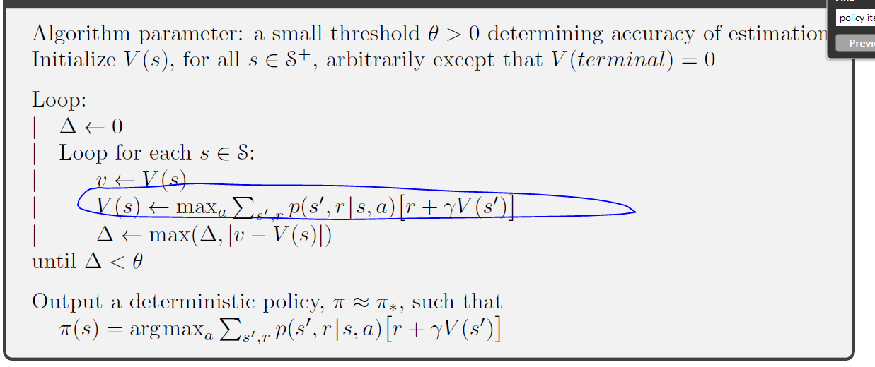
Value Iteration
According to Bellman Optimality Equation -> Next Slides
→ for state value convergence.
Notes:
S8 = San Fransisco , San Bruno which way , choosing which state would arrive at most score? Which is what we are trying to achieve, traffic , money , possibility of travel failure etc.

Slide 9
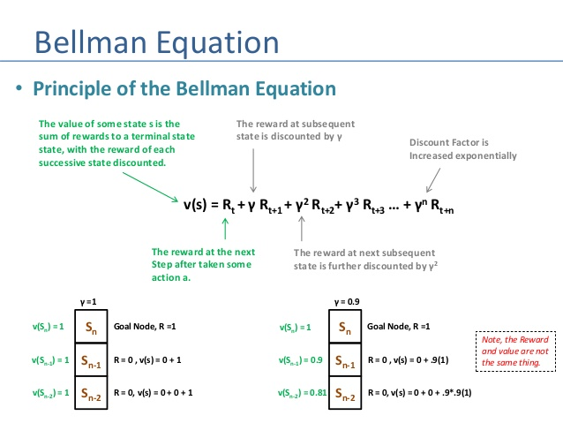
Notes:
S8 = San Fransisco , San Bruno which way , choosing which state would arrive at most score? Which is what we are trying to achieve, traffic , money , possibility of travel failure etc.

Slide 10
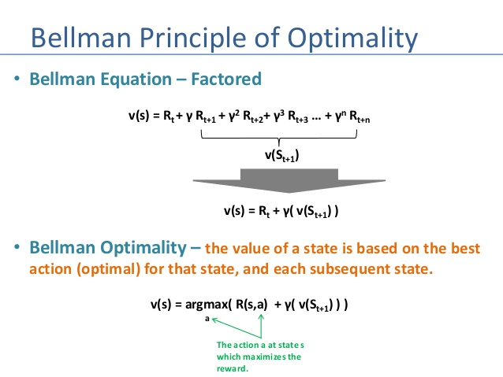
Notes:
S8 = San Fransisco , San Bruno which way , choosing which state would arrive at most score? Which is what we are trying to achieve, traffic , money , possibility of travel failure etc.

Slide 11
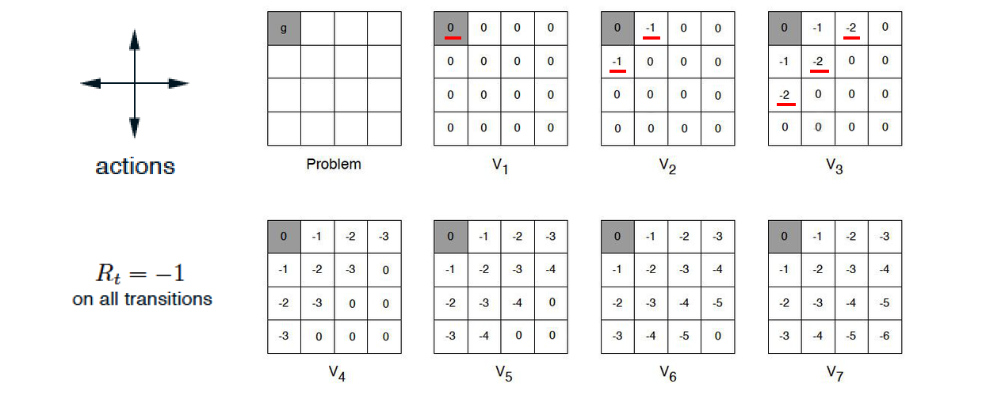
Value Iteration
According to Bellman Optimality Equation -> Next Slides
→ for state value convergence.
Notes:
S8 = San Fransisco , San Bruno which way , choosing which state would arrive at most score? Which is what we are trying to achieve, traffic , money , possibility of travel failure etc.

Slide 12

Value Iteration
CODING TIME
According to Bellman Optimality Equation -> Next Slides
→ for state value convergence.
Notes:
S8 = San Fransisco , San Bruno which way , choosing which state would arrive at most score? Which is what we are trying to achieve, traffic , money , possibility of travel failure etc.

Slide 13
02
Policy Evaluation
“I'm not a great programmer; I'm just a good programmer with great habits.” – Kent Beck

Slide 14
Policy Evaluation
Policy tells which action to choose in a particular given state.
We already know how to calculate value of state. If we took random policy, each action has the same probability. For four possible actions, π(a|s) equals 0.25 for any state.So we can calculate it with given probability.
Notes:
S8 = San Fransisco , San Bruno which way , choosing which state would arrive at most score? Which is what we are trying to achieve, traffic , money , possibility of travel failure etc.

Slide 15
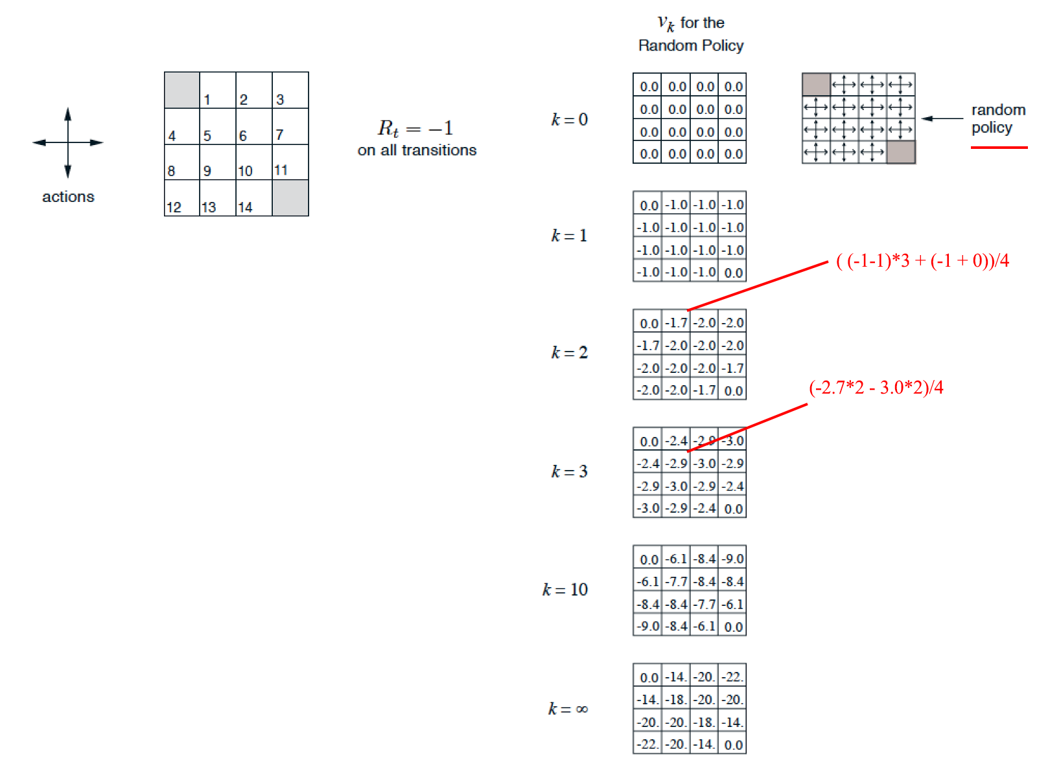
Policy Evaluation
Notes:
S8 = San Fransisco , San Bruno which way , choosing which state would arrive at most score? Which is what we are trying to achieve, traffic , money , possibility of travel failure etc.

Slide 16
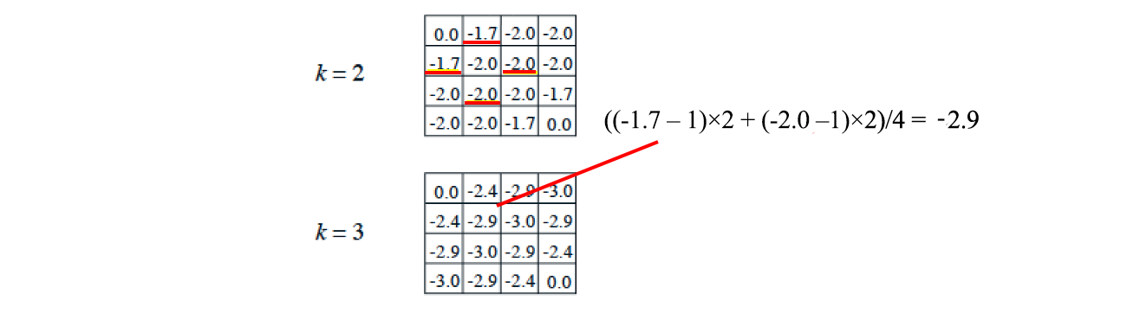
Policy Evaluation
For iteration 3 V[2,2] = -2.9 . Substract –1 (environment detail) from each move
Take average. That’s it.
Stopping would be similar as last example. It's proven if you go infinite it would be optimal policy :)
Notes:
S8 = San Fransisco , San Bruno which way , choosing which state would arrive at most score? Which is what we are trying to achieve, traffic , money , possibility of travel failure etc.

Slide 17
Policy Evaluation
CODING TIME
Notes:
S8 = San Fransisco , San Bruno which way , choosing which state would arrive at most score? Which is what we are trying to achieve, traffic , money , possibility of travel failure etc.

Slide 18
03
Policy Iteration
“That's one small step for man, one giant leap for mankind” N.Armstrong

Slide 19
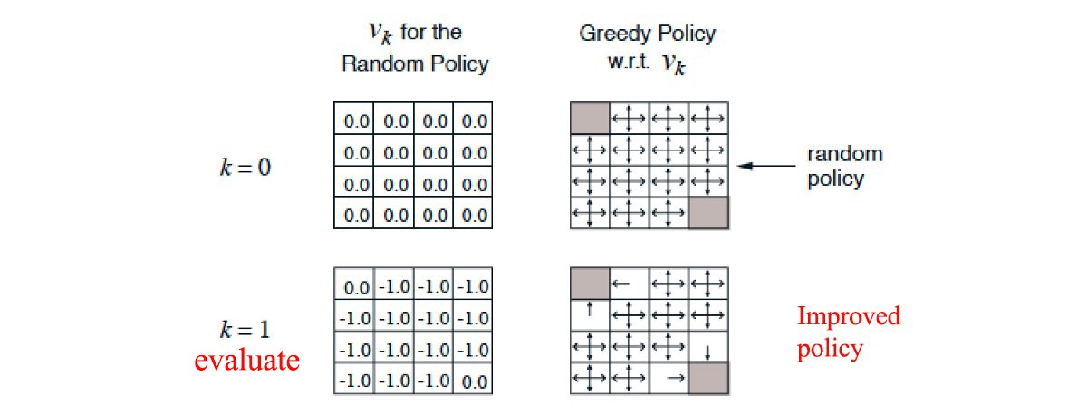
Policy Iteration
We still use "policy evaluation"
But we also improve policy based on evaluation , rather than keeping random policy
Notes:
S8 = San Fransisco , San Bruno which way , choosing which state would arrive at most score? Which is what we are trying to achieve, traffic , money , possibility of travel failure etc.

Slide 20
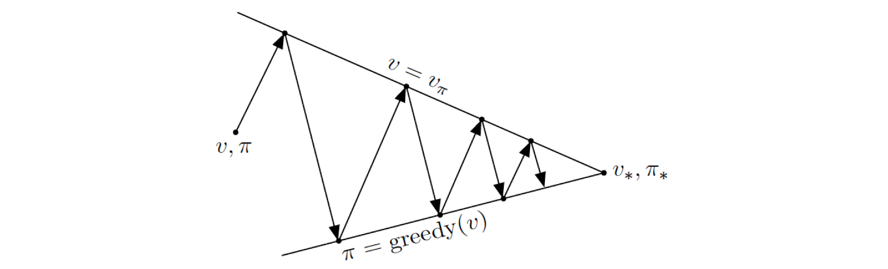
Policy Iteration
We still use "policy evaluation"
But we also improve policy based on evaluation , rather than keeping random policy , using a greed policy for example
Notes:
S8 = San Fransisco , San Bruno which way , choosing which state would arrive at most score? Which is what we are trying to achieve, traffic , money , possibility of travel failure etc.

Slide 21
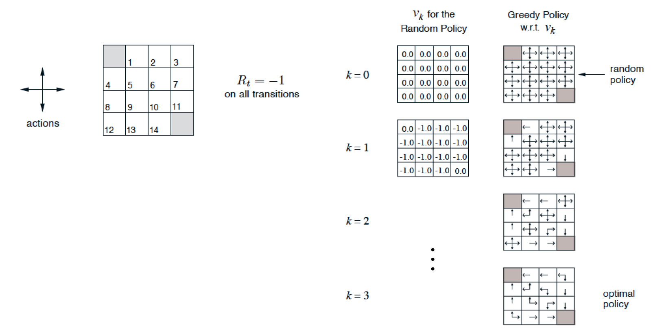
Policy Iteration
Notes:
S8 = San Fransisco , San Bruno which way , choosing which state would arrive at most score? Which is what we are trying to achieve, traffic , money , possibility of travel failure etc.

Slide 22
Policy Iteration
P is the model (system dynamics) determining the next state after taking an action. The refined policy will be
Notes:
S8 = San Fransisco , San Bruno which way , choosing which state would arrive at most score? Which is what we are trying to achieve, traffic , money , possibility of travel failure etc.

Slide 23
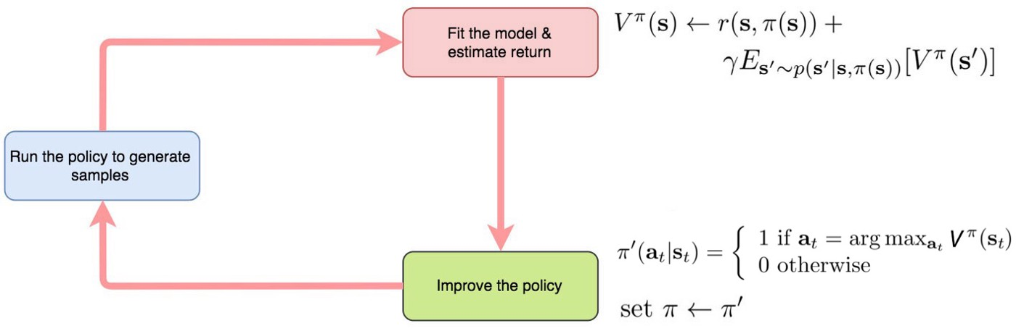
Policy Iteration
Notes:
S8 = San Fransisco , San Bruno which way , choosing which state would arrive at most score? Which is what we are trying to achieve, traffic , money , possibility of travel failure etc.

Slide 24
Policy Iteration
CODING TIME
Notes:
S8 = San Fransisco , San Bruno which way , choosing which state would arrive at most score? Which is what we are trying to achieve, traffic , money , possibility of travel failure etc.

Slide 25
04
Multi Armed Bandits
“That's one small step for man, one giant leap for mankind” N.Armstrong

Slide 26
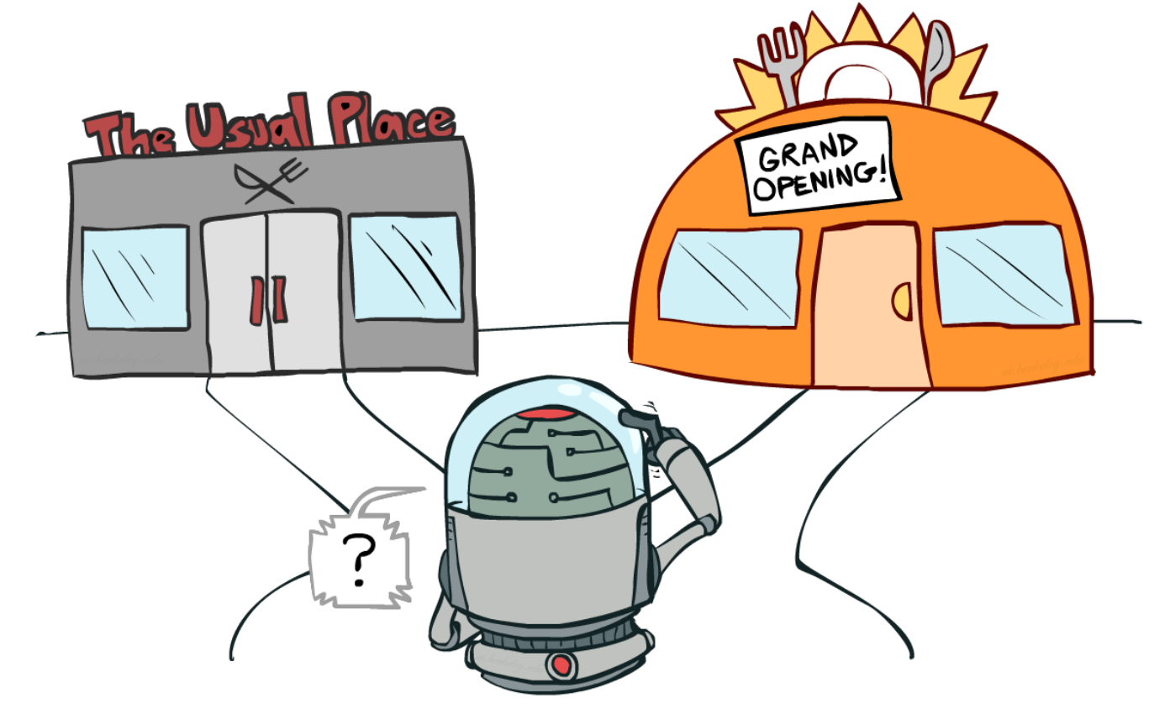
Exploitation vs Exploration
If you know all info about environment , just brute force even would find optimal policy.
But in reality you don't (for most of time).
This is where more smart approaches comes in.
This balance and how to achieve is still one of the active topics in RL that isn't solved.
But we have some working albeit hacky and not enough solutions that works for now
(Greedy,Gaussian noise , random noise etc)
Notes:
S8 = San Fransisco , San Bruno which way , choosing which state would arrive at most score? Which is what we are trying to achieve, traffic , money , possibility of travel failure etc.

Slide 27
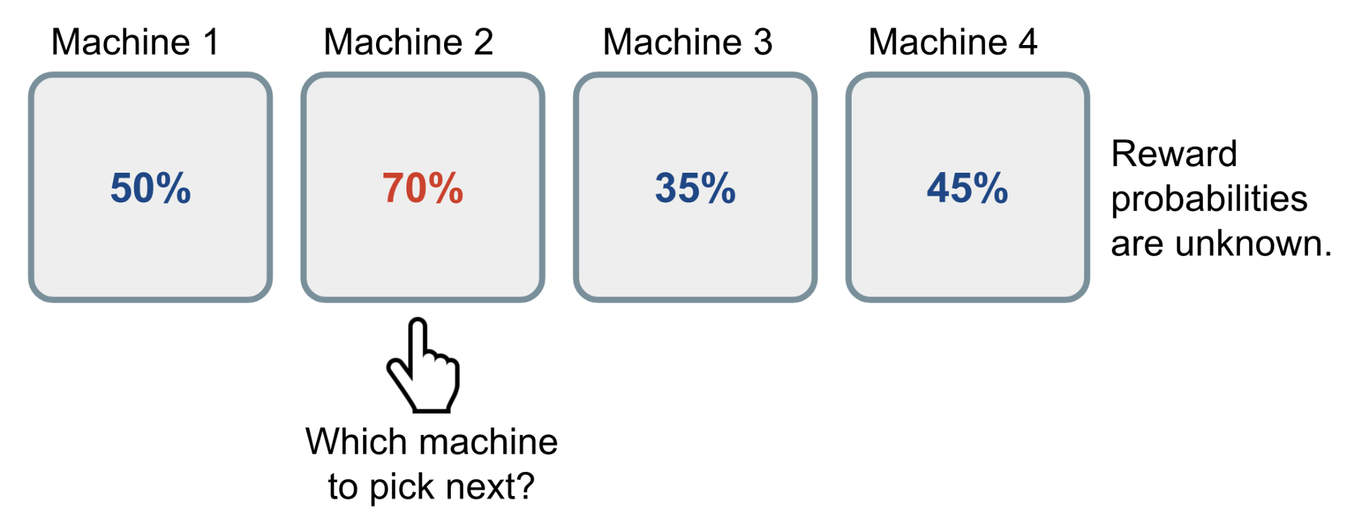
What's multi armed bandit problem
Classical RL problem that demonstrate what we just talked about exploration and exploitation.
You are vegas and you are in front of slot machine. Hey I know RL bit why not use it?
Find me best solution to get all money(highest long term reward)
This example is from Bernoulli m-armed bandit.Reward probs are not known to user.
You may think just play randomly and you will get best , but it doesn't guarentee best long term reward.
https://en.wikipedia.org/wiki/Law_of_large_numbers -> do it much you as you can then it will be close to expected value. Well it gets some value but not best nor it's useful
Notes:
S8 = San Fransisco , San Bruno which way , choosing which state would arrive at most score? Which is what we are trying to achieve, traffic , money , possibility of travel failure etc.

Slide 28
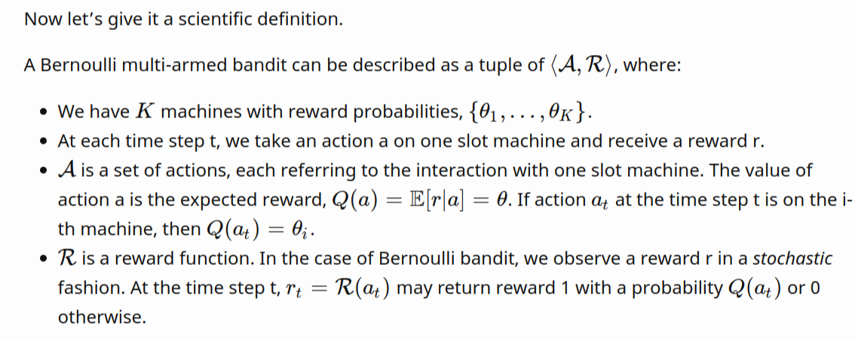
Solution methods
No exploration: the most naive approach and a bad one.
Exploration at random
Exploration smartly with preference to uncertainty
(no state in below img for simplicity purposes)
Notes:
S8 = San Fransisco , San Bruno which way , choosing which state would arrive at most score? Which is what we are trying to achieve, traffic , money , possibility of travel failure etc.

Slide 29
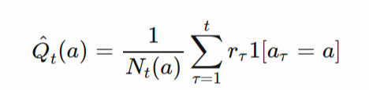
E- Greedy
Given probability you either exploit -> aka take best action given Q function bigger chance
Or do random exploration -> small chance
In general greedy choosen a small value so you will exploit more but explore less (even more so after some time in training – learning hence we expect it would be already in solid state so random exploration would be bad thing %50 %50)
Obviously we are talking random exploration , because if we had better exploration technique this wouldn't be case.
1-e -> our policy
E – random exploration
Related to image here 1 is a binary indicator function and Nt(a) is how many times the action a has been selected so far,
Notes:
S8 = San Fransisco , San Bruno which way , choosing which state would arrive at most score? Which is what we are trying to achieve, traffic , money , possibility of travel failure etc.

Slide 30
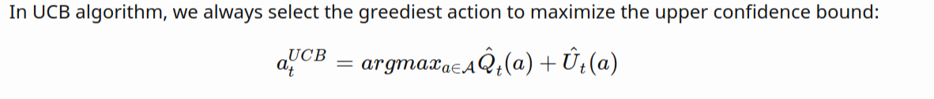
Upper Confidence Bounds
Random exploration while works fine in some cases , but due the it's randomness (no pun intended) it is real possibility
That we miss lots good actions and instead we explore a bad action that we even knew it was bad (bad luck?)
As you can see it's inefficient exploration. One way to solve it ( is we talked decrease e param) , but other way to solve it we favor exploration of actions with strong potential to have optimal value.
UCB algorithm measures this upper confidience bound of Reward value -> Ut(Action>)
So true value of a state is below with a bound
Q(Action) <= Q'(Action) + Ut(Action) . Ut(Action) is a function with large number of trials should give us a smaller bound in the end.
Notes:
S8 = San Fransisco , San Bruno which way , choosing which state would arrive at most score? Which is what we are trying to achieve, traffic , money , possibility of travel failure etc.

Slide 31
How to estimate Upper Confidence Bound
Hoeffding’s Inequality = No prior knowledge about how distribution works/looks like , any bounded distribution works with it.
UCB1 = Heuristic way to reduce threshold in time to make it more confident (as more rewards came in)
Bayesian UCB = If you know estimations about distribution, better way
Thompson Sampling = A,Beta (prior knowledge) of each taken action
Notes:
S8 = San Fransisco , San Bruno which way , choosing which state would arrive at most score? Which is what we are trying to achieve, traffic , money , possibility of travel failure etc.

Slide 32
Thanks
Q&A
Ugurkan Ates
ugurkanates97@gmail.com

Slide 33
Sources
https://lilianweng.github.io/lil-log/2018/01/23/the-multi-armed-bandit-problem-and-its-solutions.html#what-is-multi-armed-bandit
https://towardsdatascience.com/solving-the-multi-armed-bandit-problem-b72de40db97c
https://medium.com/@jonathan_hui/rl-value-learning-24f52b49c36d
https://github.com/dennybritz/reinforcement-learning/blob/master * code examples

